Slide 1

Irelian Travel Book
Inca, Lengli (50000)

Slide 2
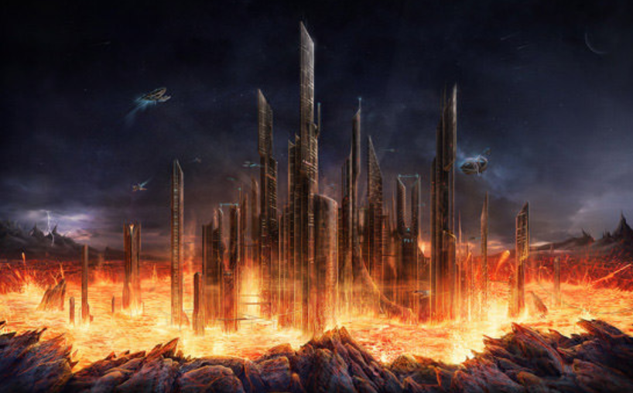
Venisca, Egypt (1 million)

Slide 3
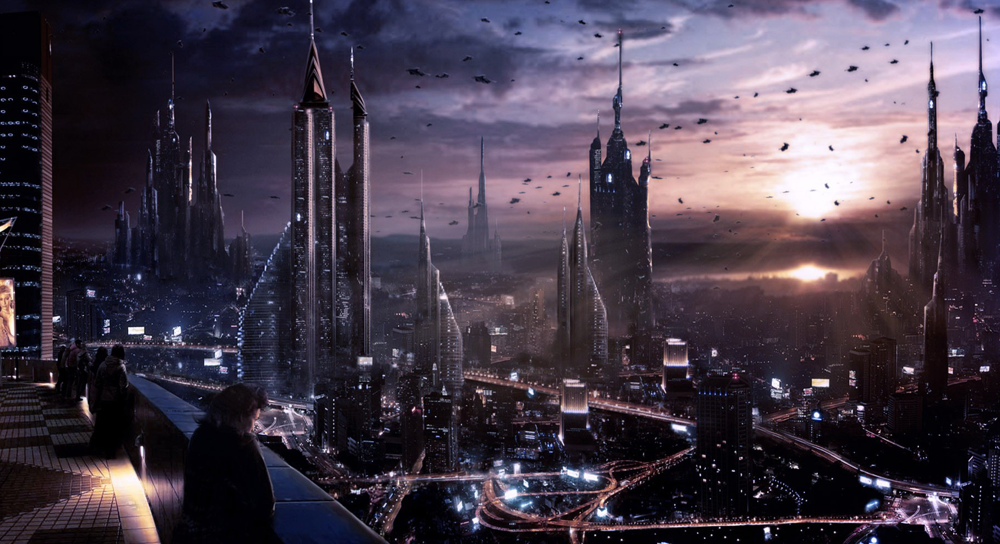
Clingo, POM (5 million)

Slide 4
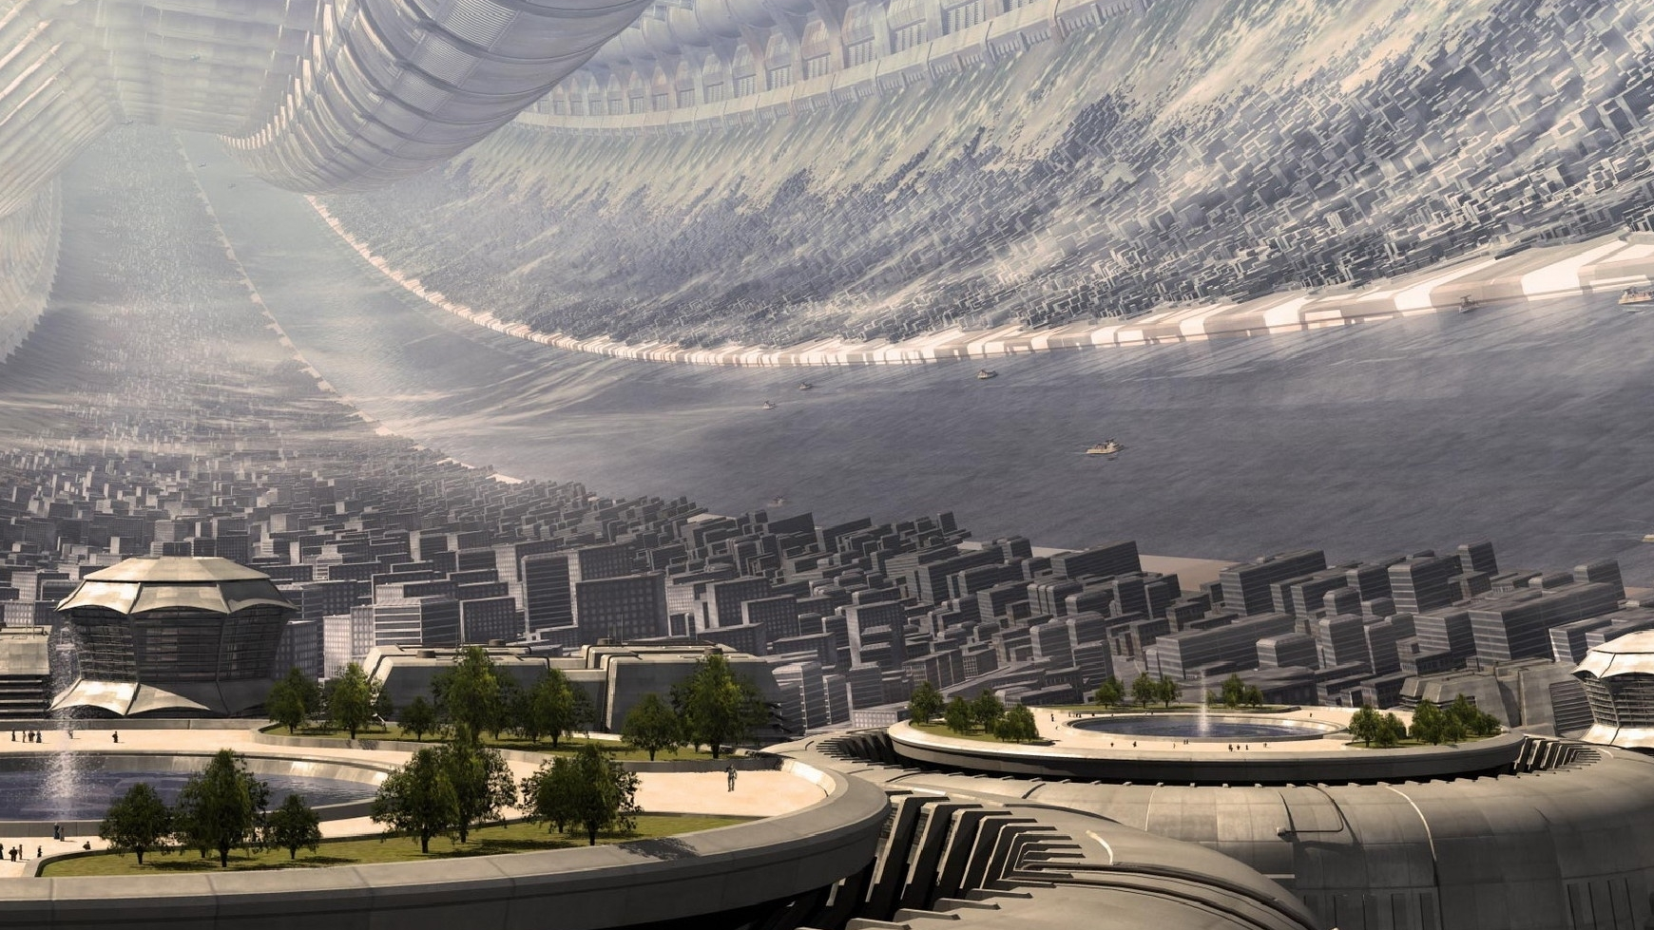
Dullice, Irelian tyre Space Station (3 million people)

Slide 5
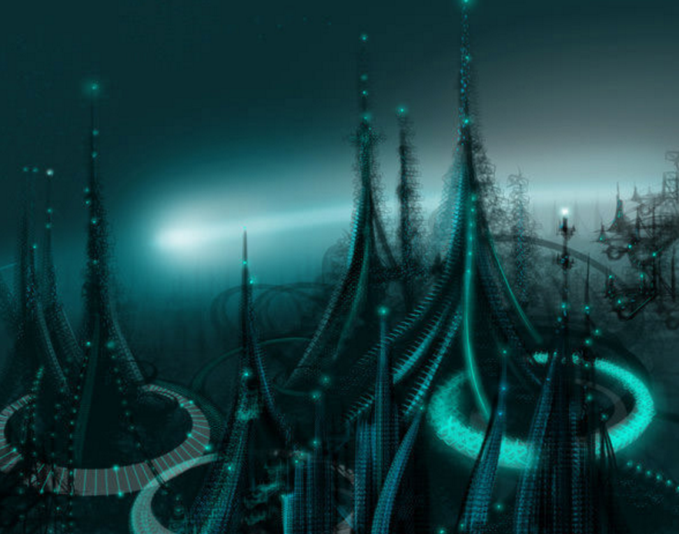
Liffle, Loon Moon (2 million)

Slide 6
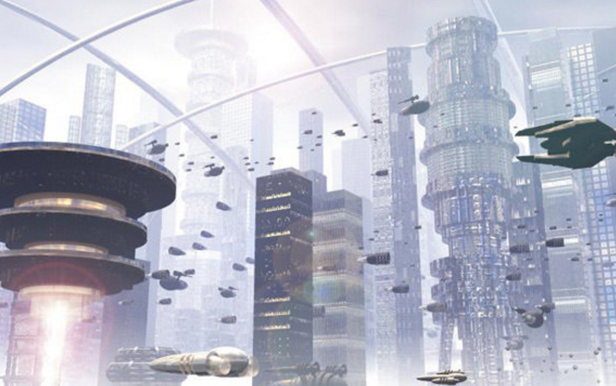
Flankton,POM (25 million)

Slide 7
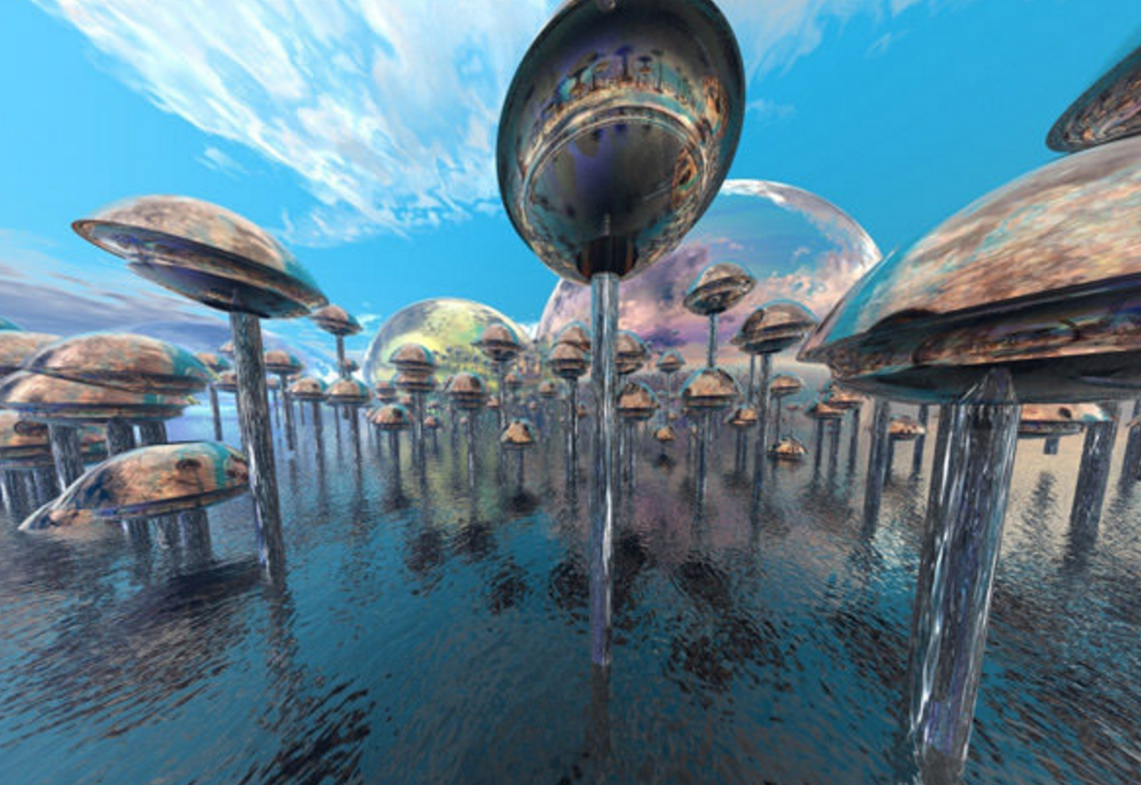
Pod tunnels, Irelian Lake (10 million)

Slide 8
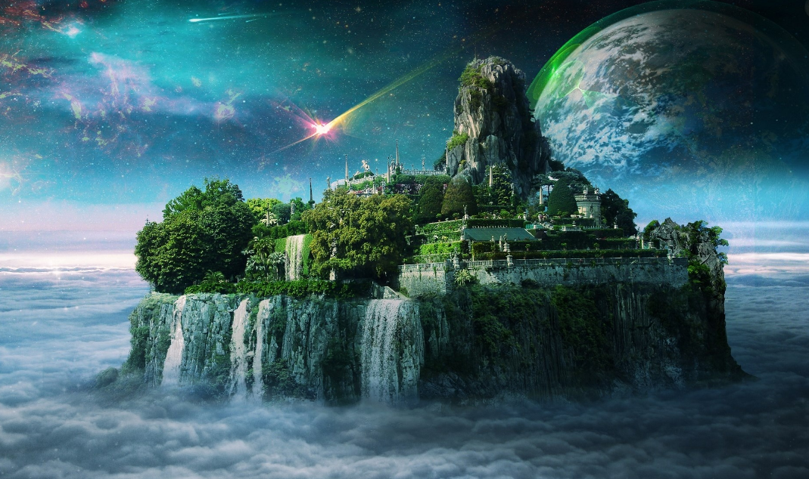
Woleno, Lengli (6k)

Slide 9
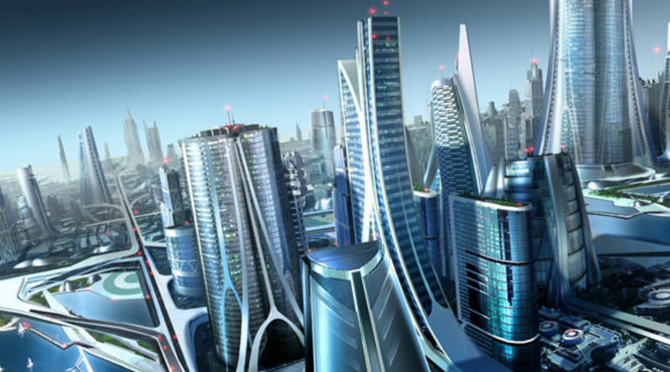
Edge Continuous part of
Powerful Magic, POM (500 million)

Slide 10
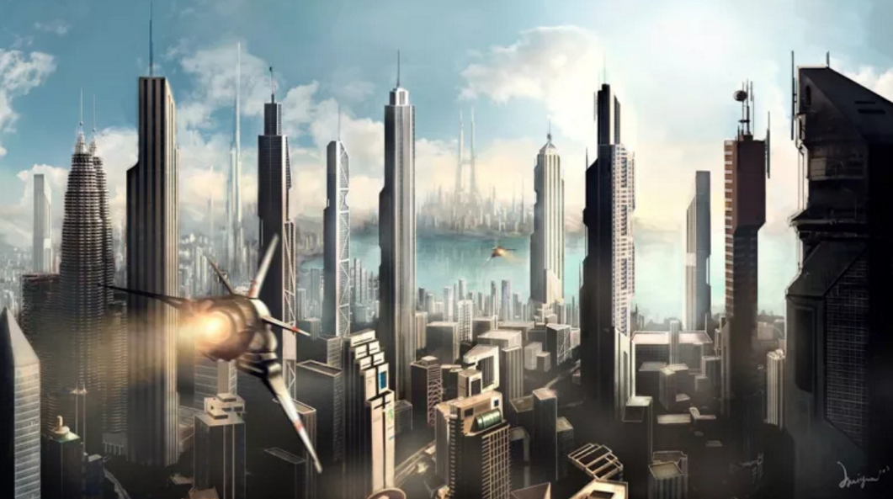
Water city (Office square) , Irelian Lake 150 million

Slide 11
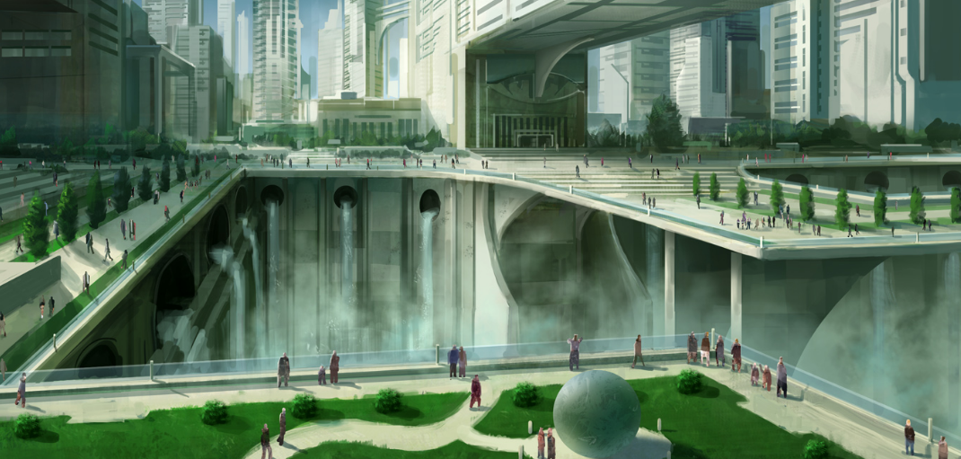
Uregra, Nilea (45 million)

Slide 12
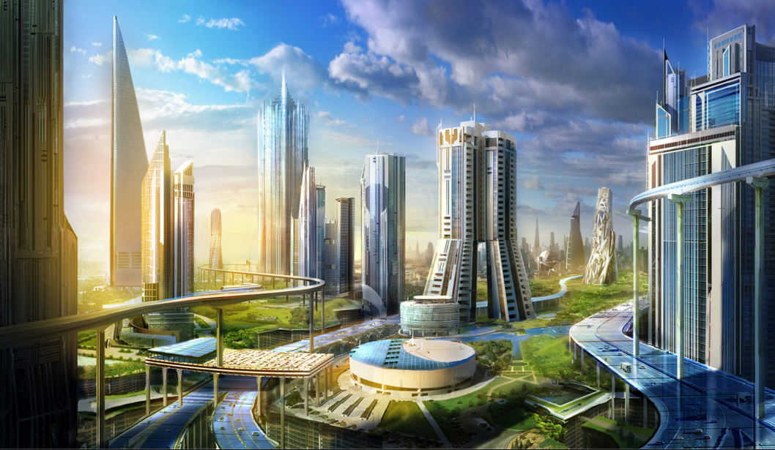
Forrestope, Forrestate (15 million)

Slide 13
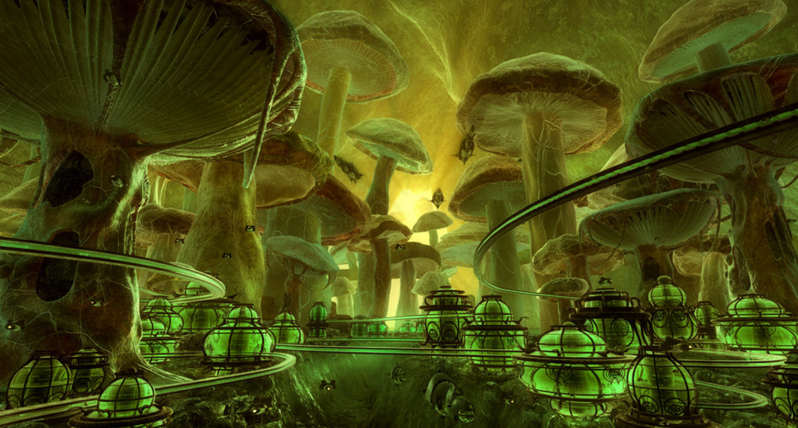
Moliya, Forrestate (3 million)

Slide 14
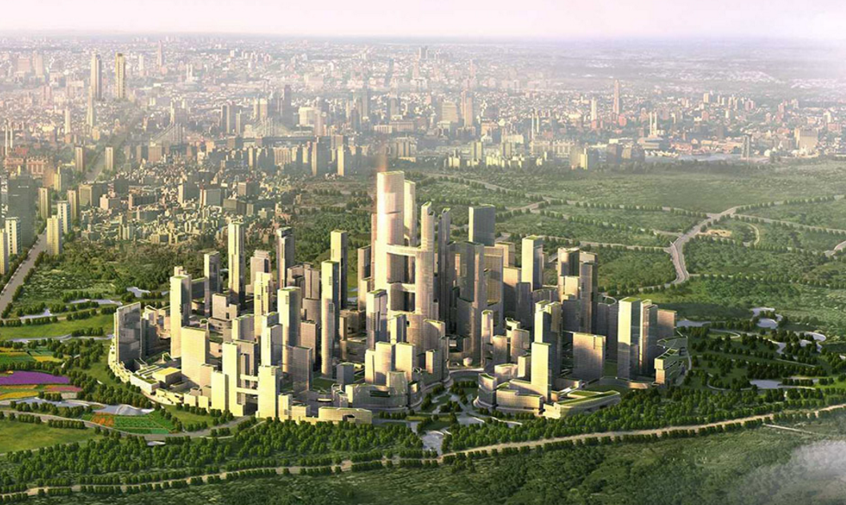
Venus (Outer Suburbs), Egypt (500 million)

Slide 15
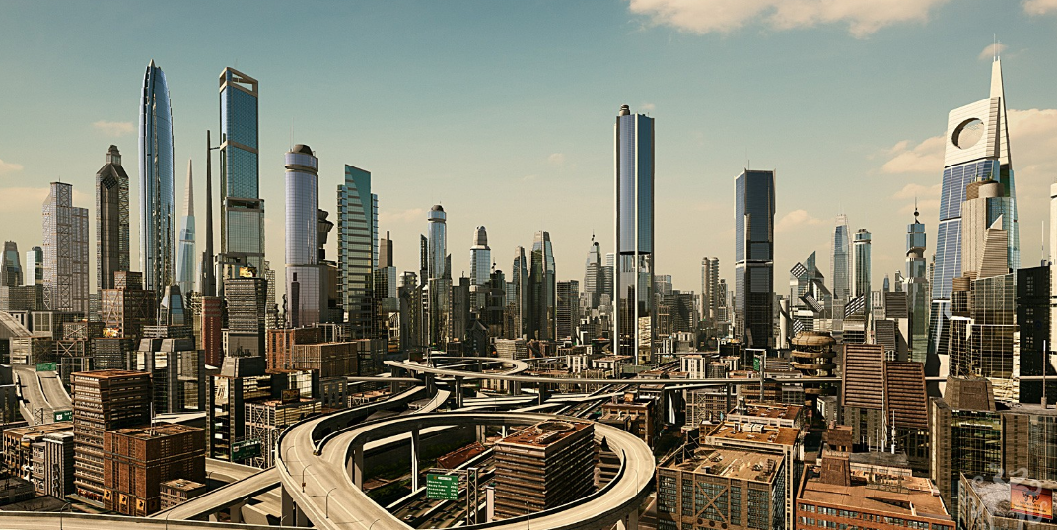
Moon City (Upper bunk), Loon Moon (330 million)

Slide 16
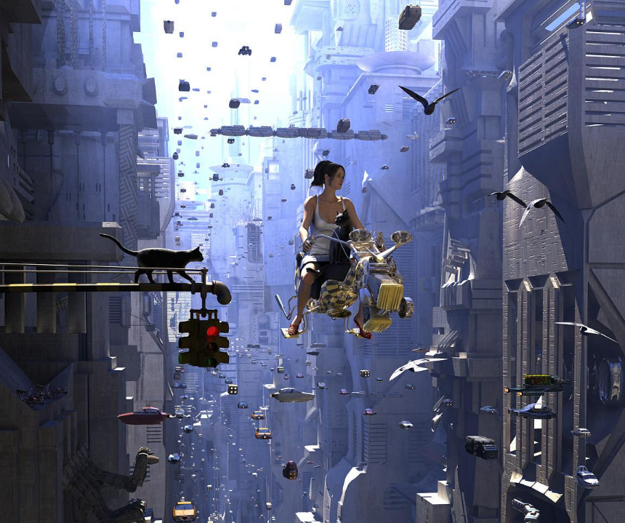
Scoots, POM (30 million)

Slide 17
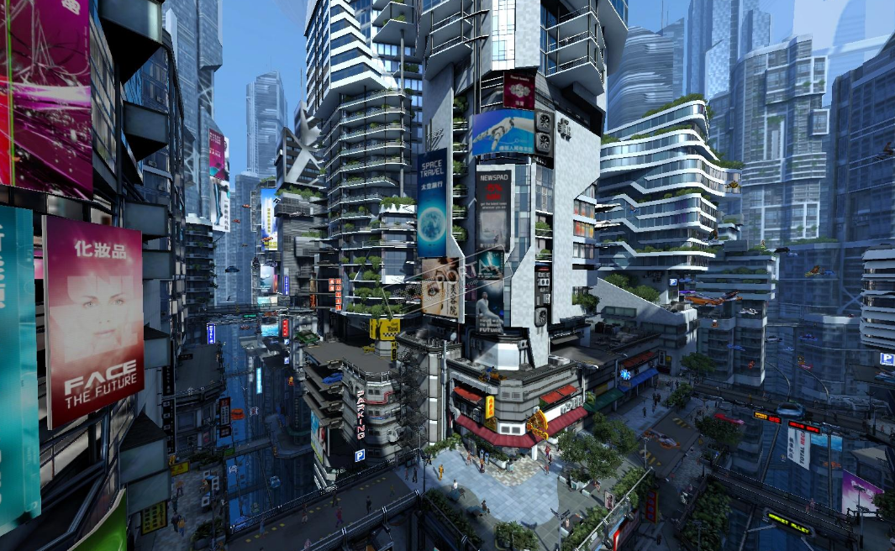
Chinart, Irelian Lake (20 million)

Slide 18
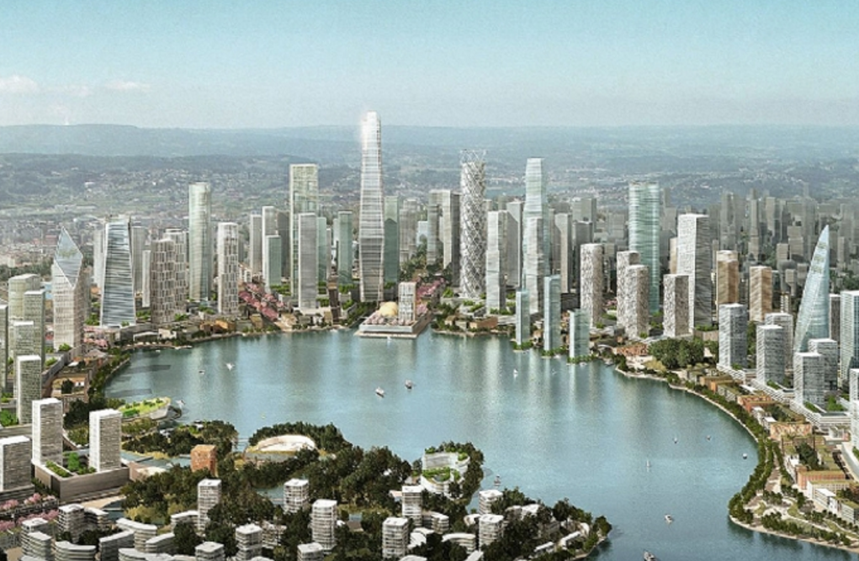
Meixi, Nilea (5 million)

Slide 19
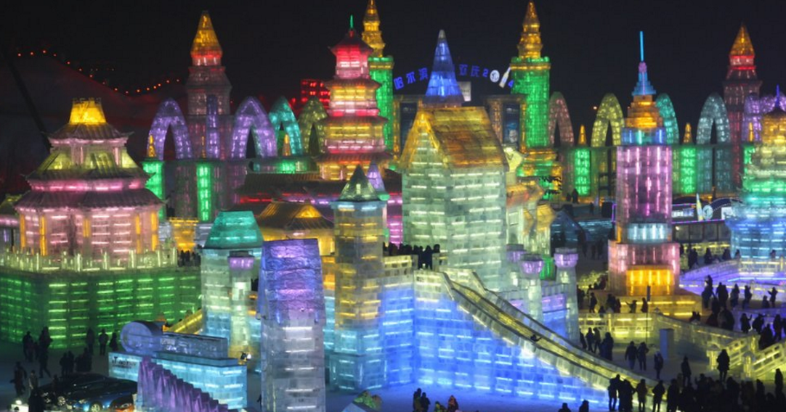
Colorice, North Pole (1 million)

Slide 20
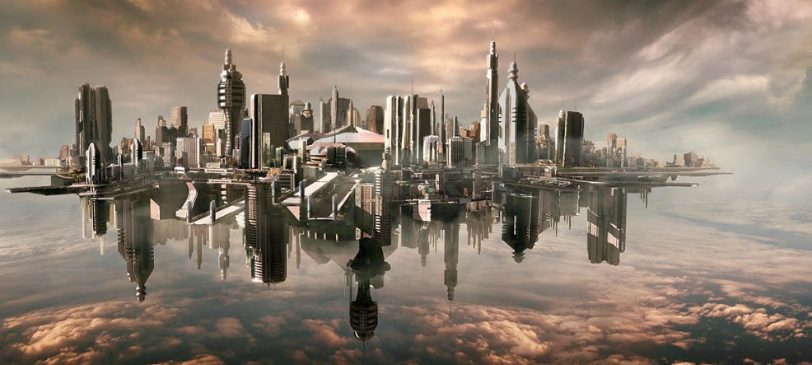
Dell, Egypt

Slide 21
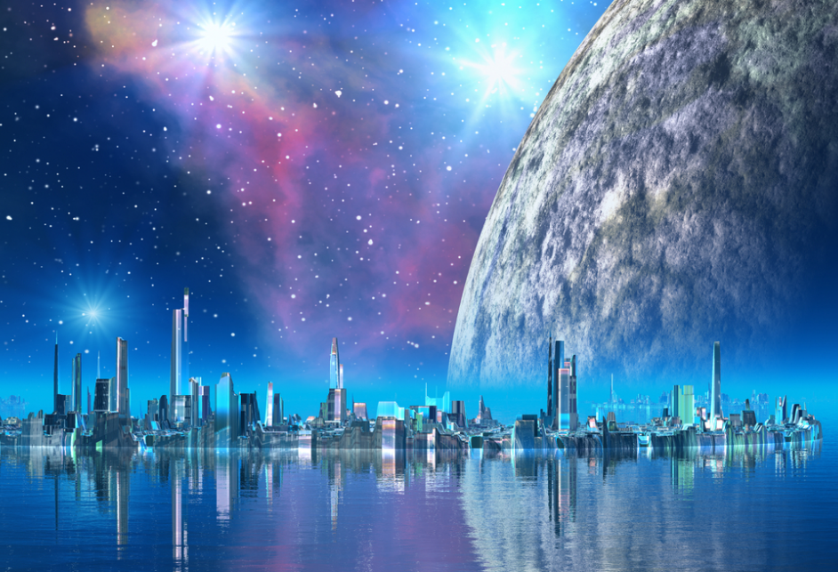
Edge city, North Pole (1 million)

Slide 22
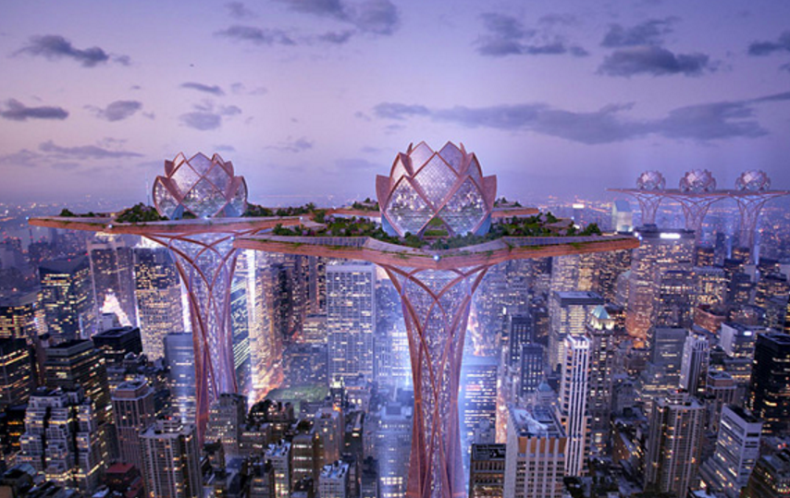
Flower city, Forrestate (11 million)

Slide 23
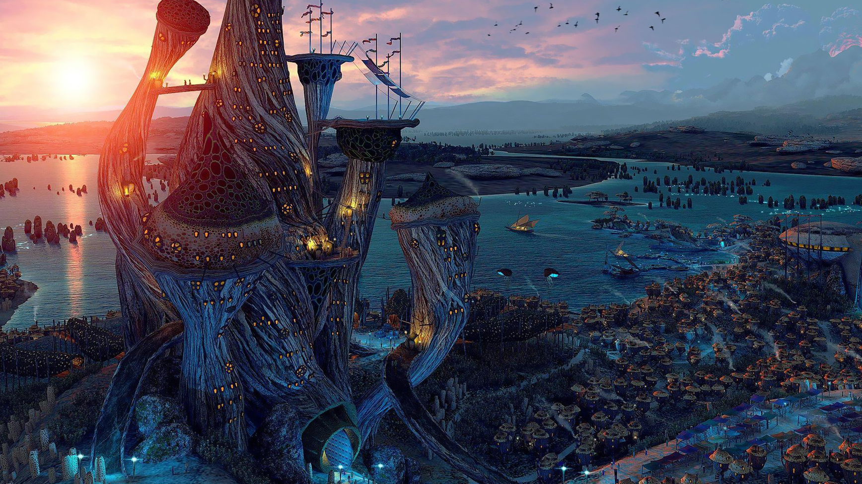
Toadsville Harbour ,Irelian lake (2 million)

Slide 24
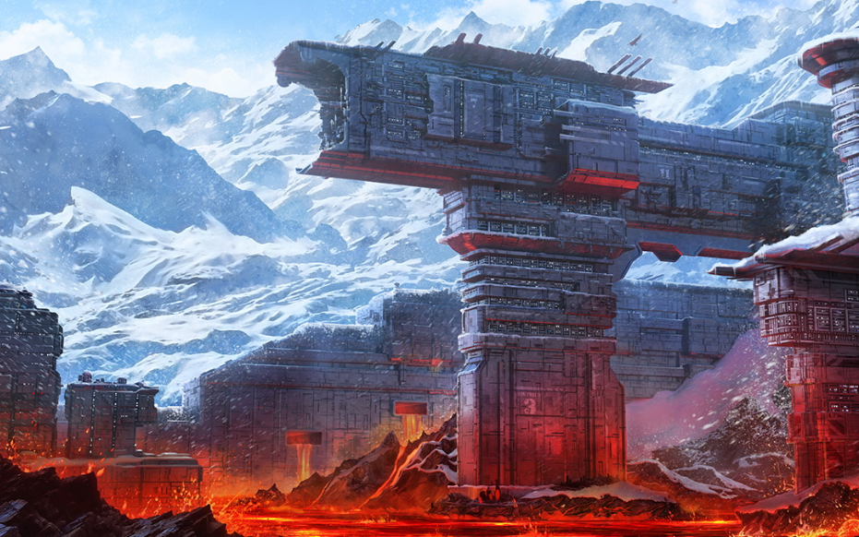
Ice and Lava City, Egypt (0.5 million)

Slide 25
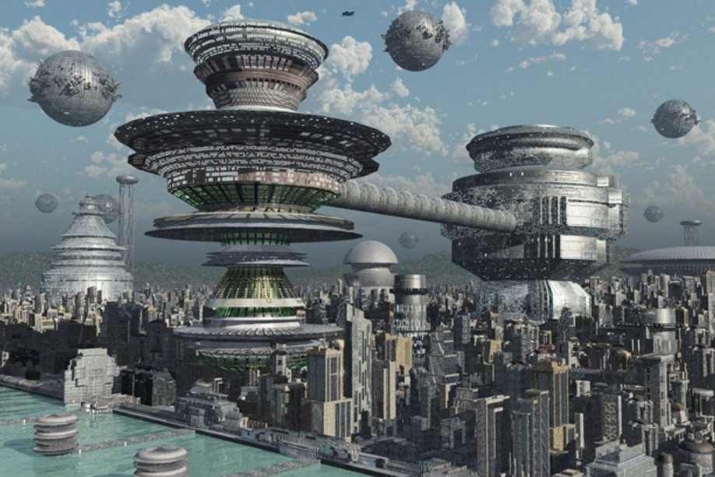
Ballend, Sectary (14 million)

Slide 26
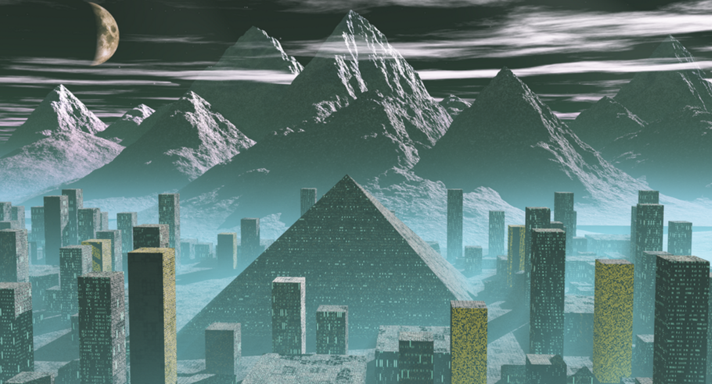
Egyptoon, Mooney (3 million)

Slide 27
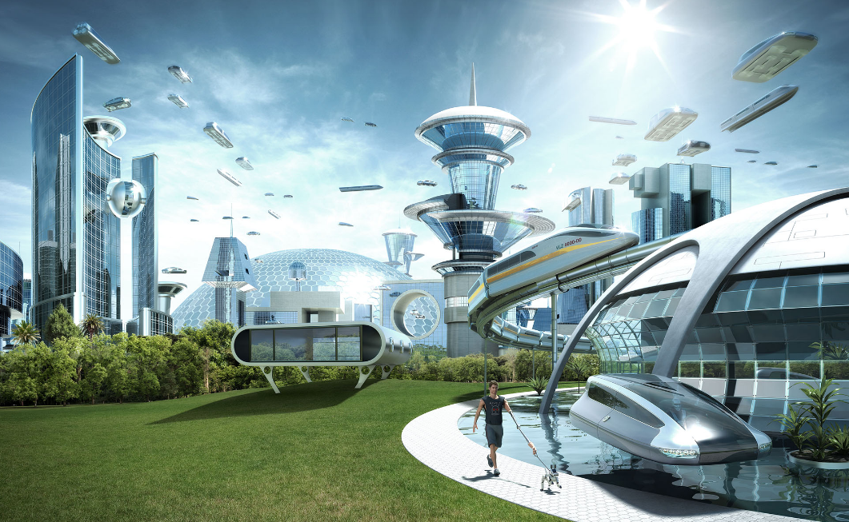
Frestome, Markyland (7 million)

Slide 28
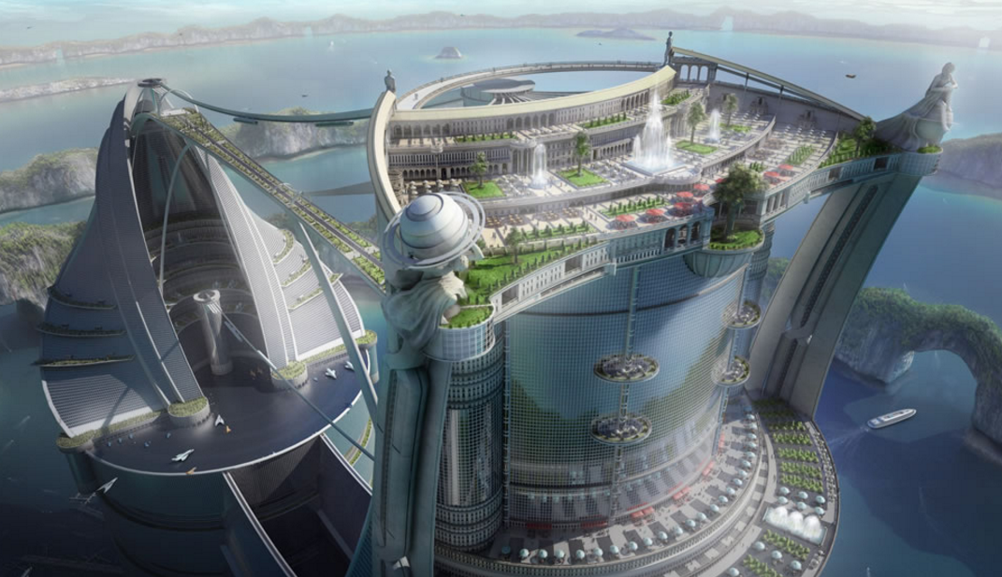
Narch, Irelian lake (50000)

Slide 29
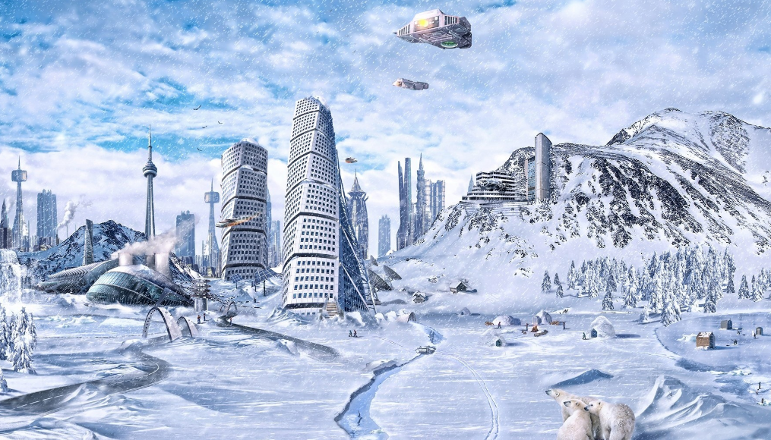
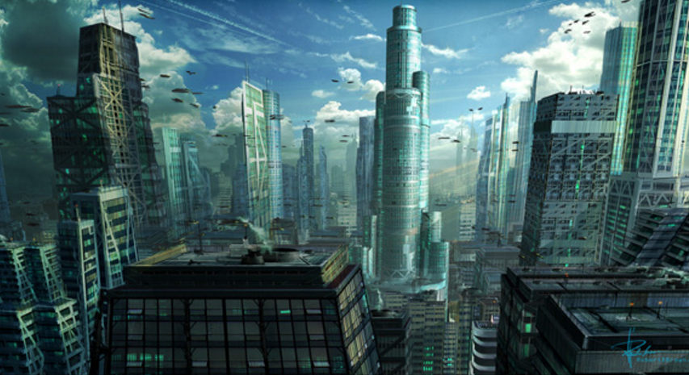
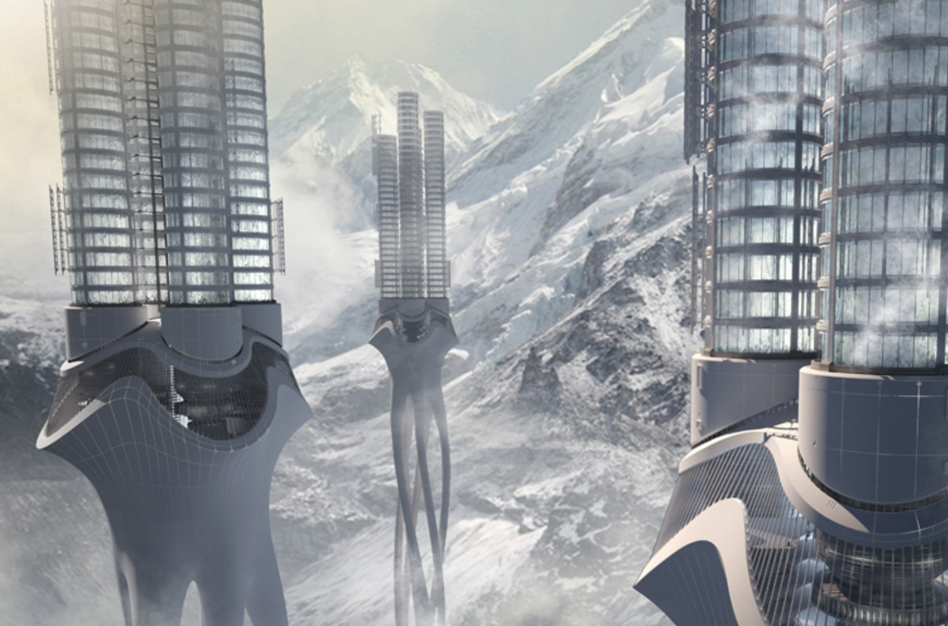
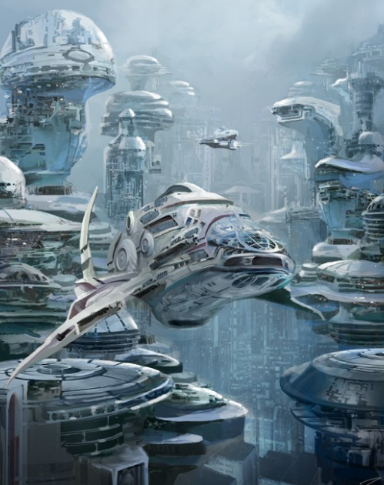
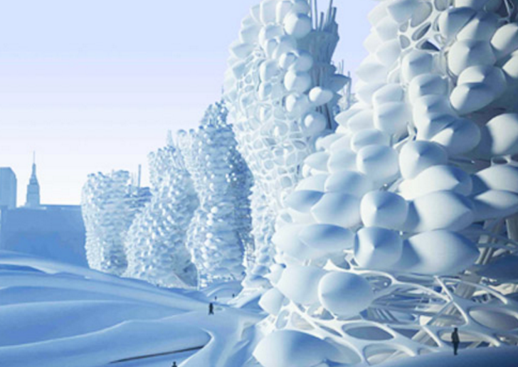
Esker, North Pole (30million)

Slide 30
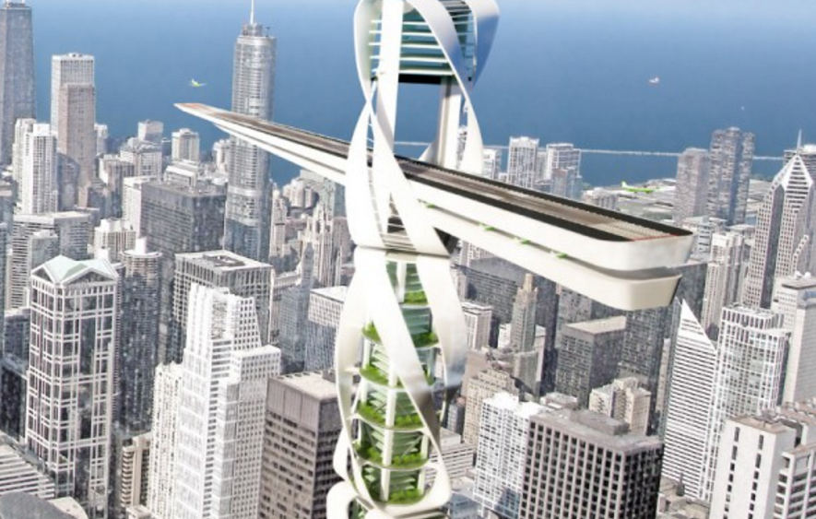
Salt city, Somalia (6 million)

Slide 31
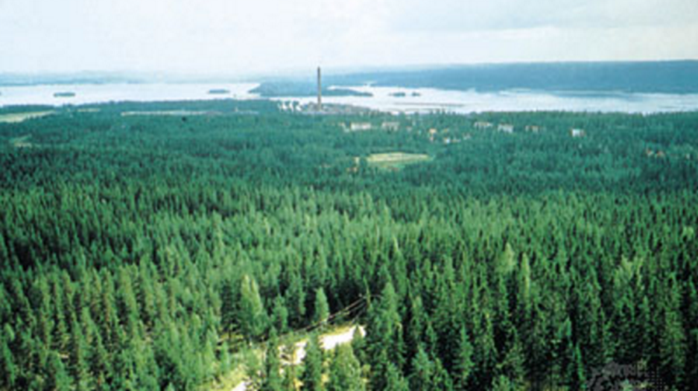
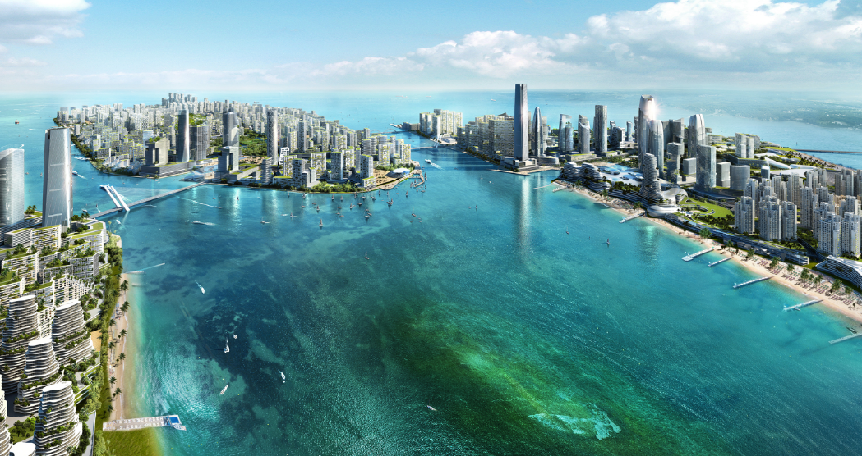
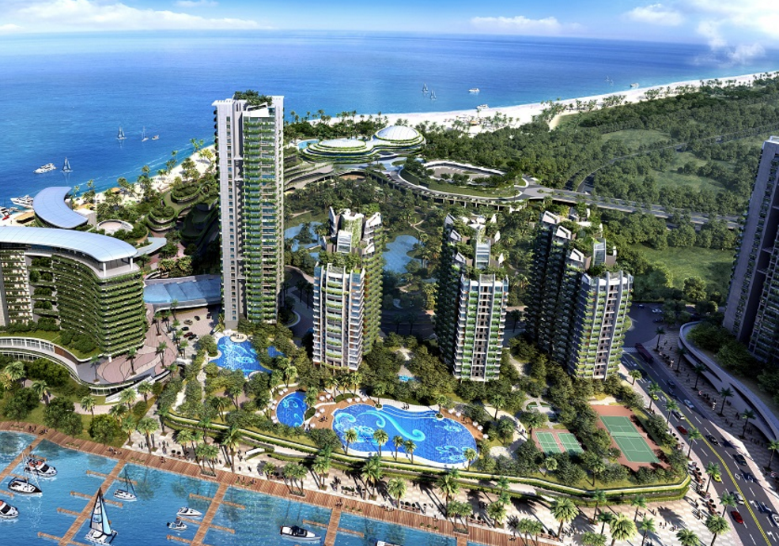
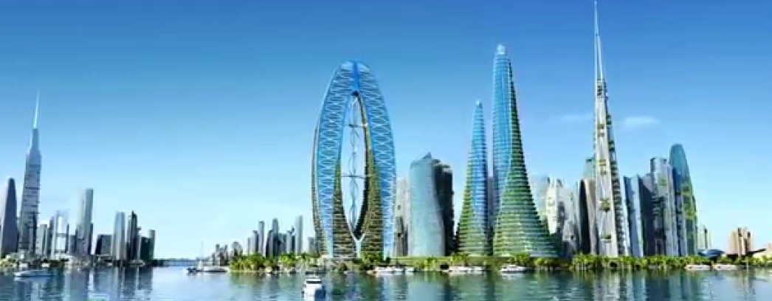
Conforri Rivers, Lengli

Slide 32
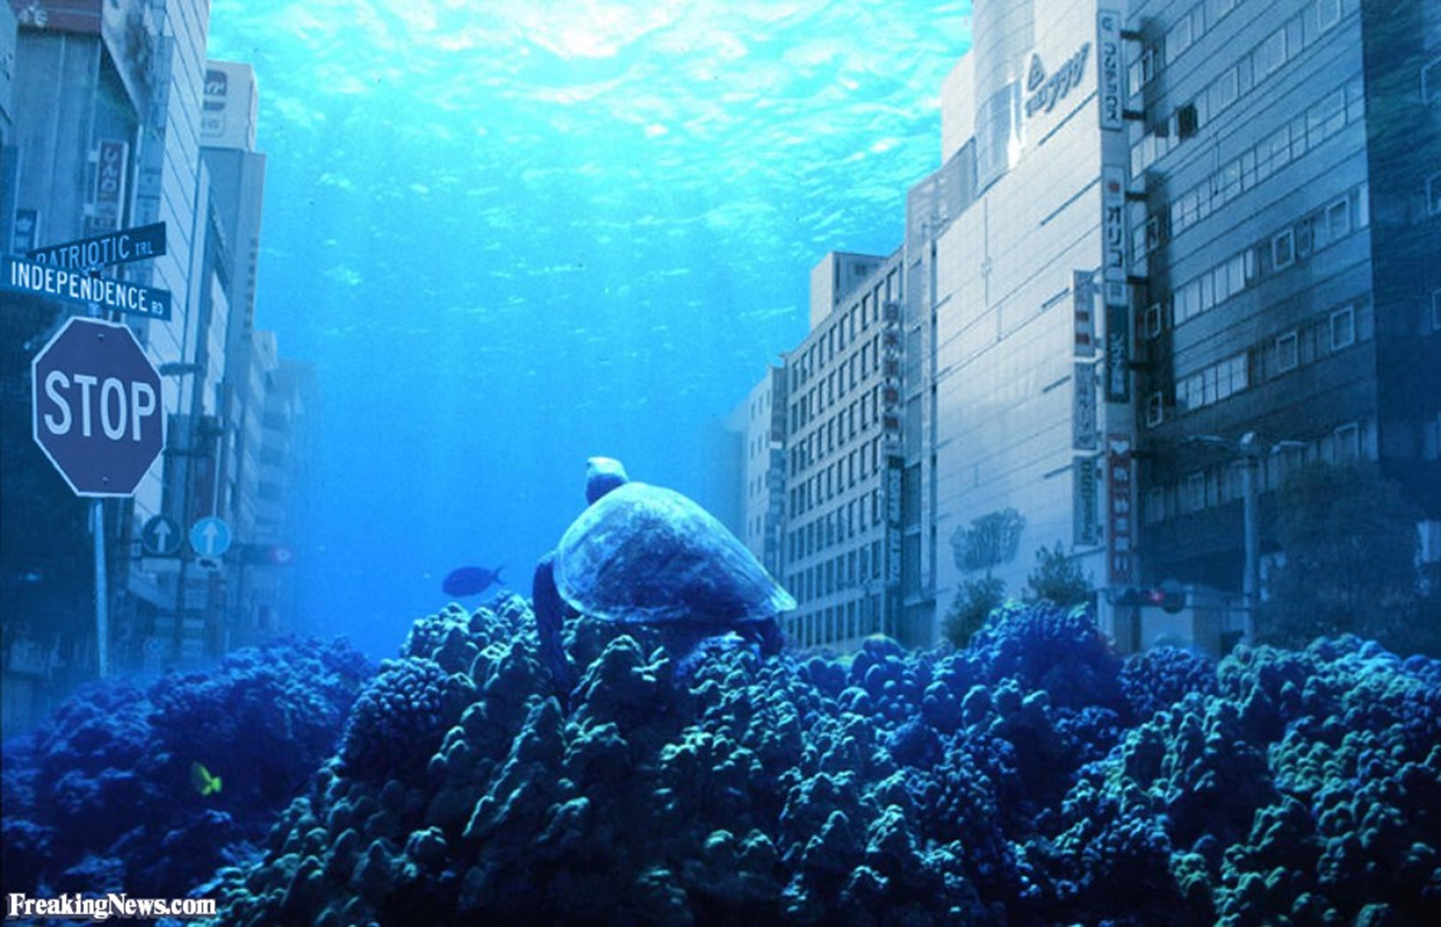
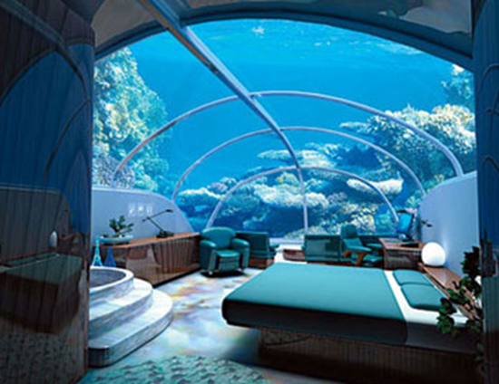
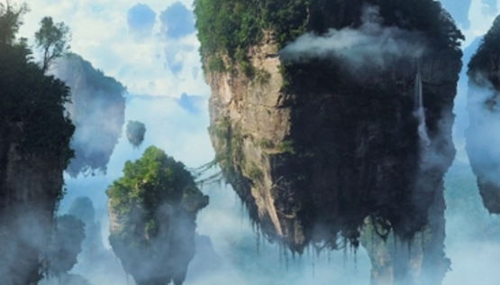
Reef city (Outer Suburbs), Irelian Lake (50 million)

Slide 33
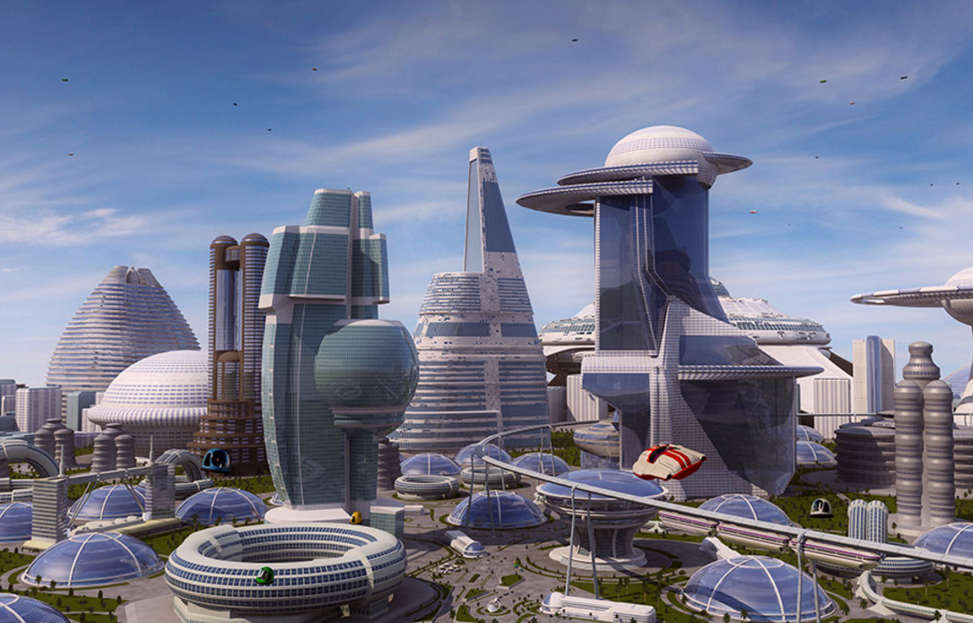
Dome-home, Forrestate (3 million)

Slide 34
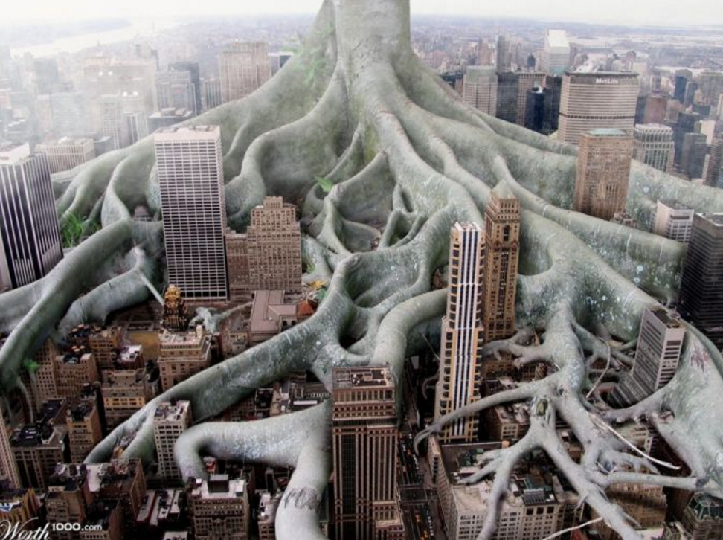
Trecity, Forrestate (7 million)

Slide 35

Flíung, Irelian Lake (200k)

Slide 36
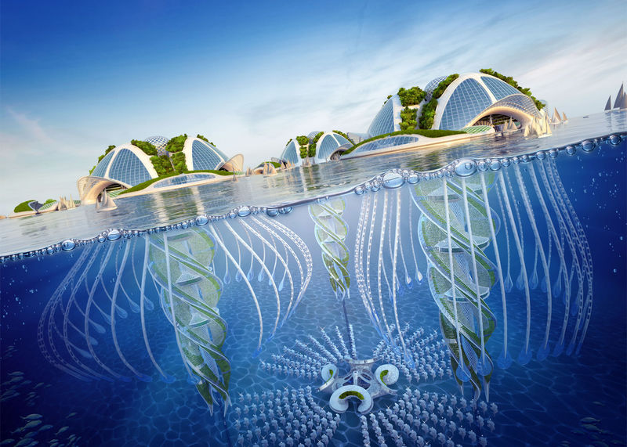
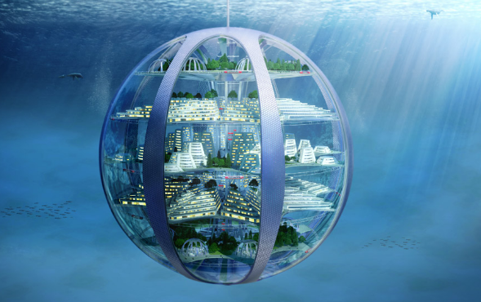
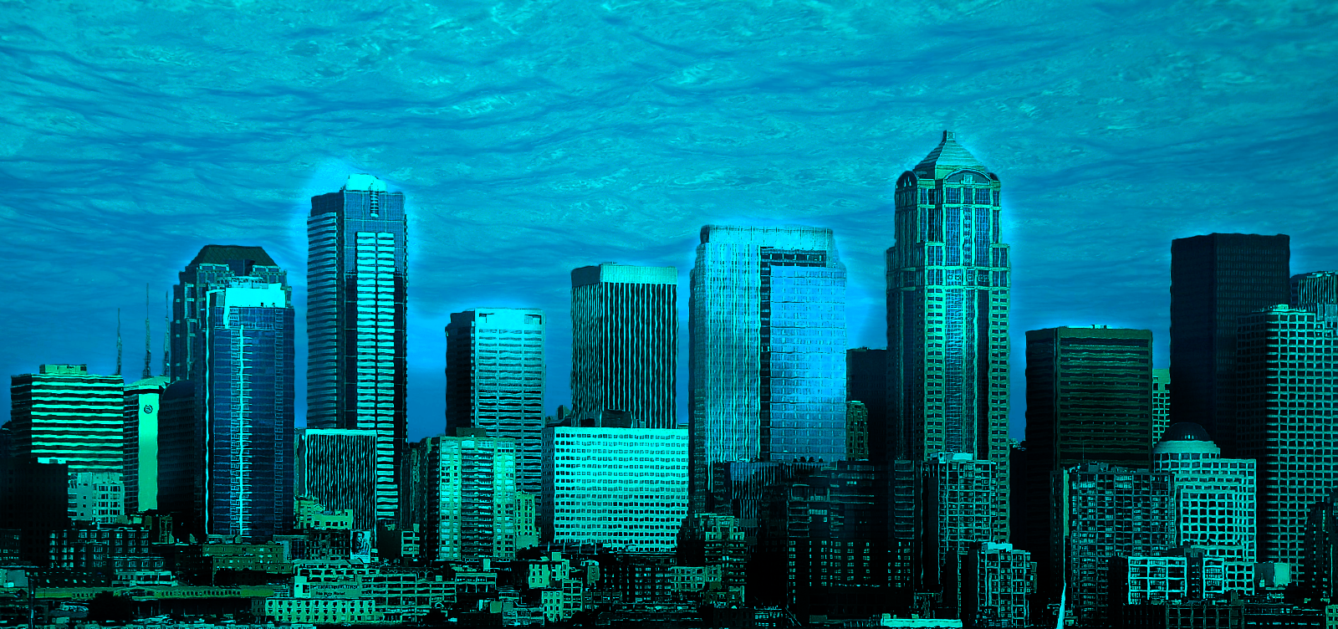
Submarine city, Irelian Lake (5 million)

Slide 37
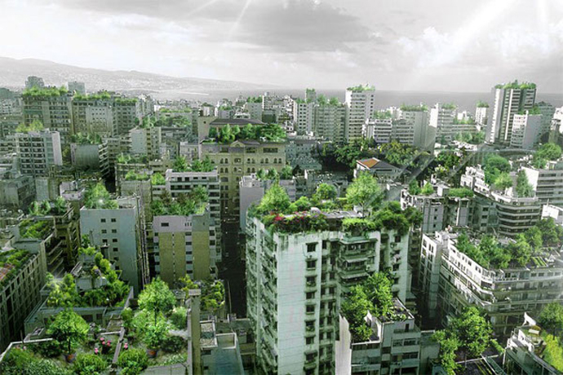
Rooftop Forrest City (Outer Suburb ‘Lazy roofs’), Forrestate (30 million)

Slide 38
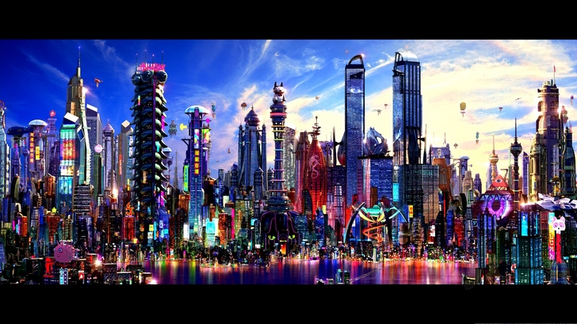
Partiland, POM (5million)

Slide 39
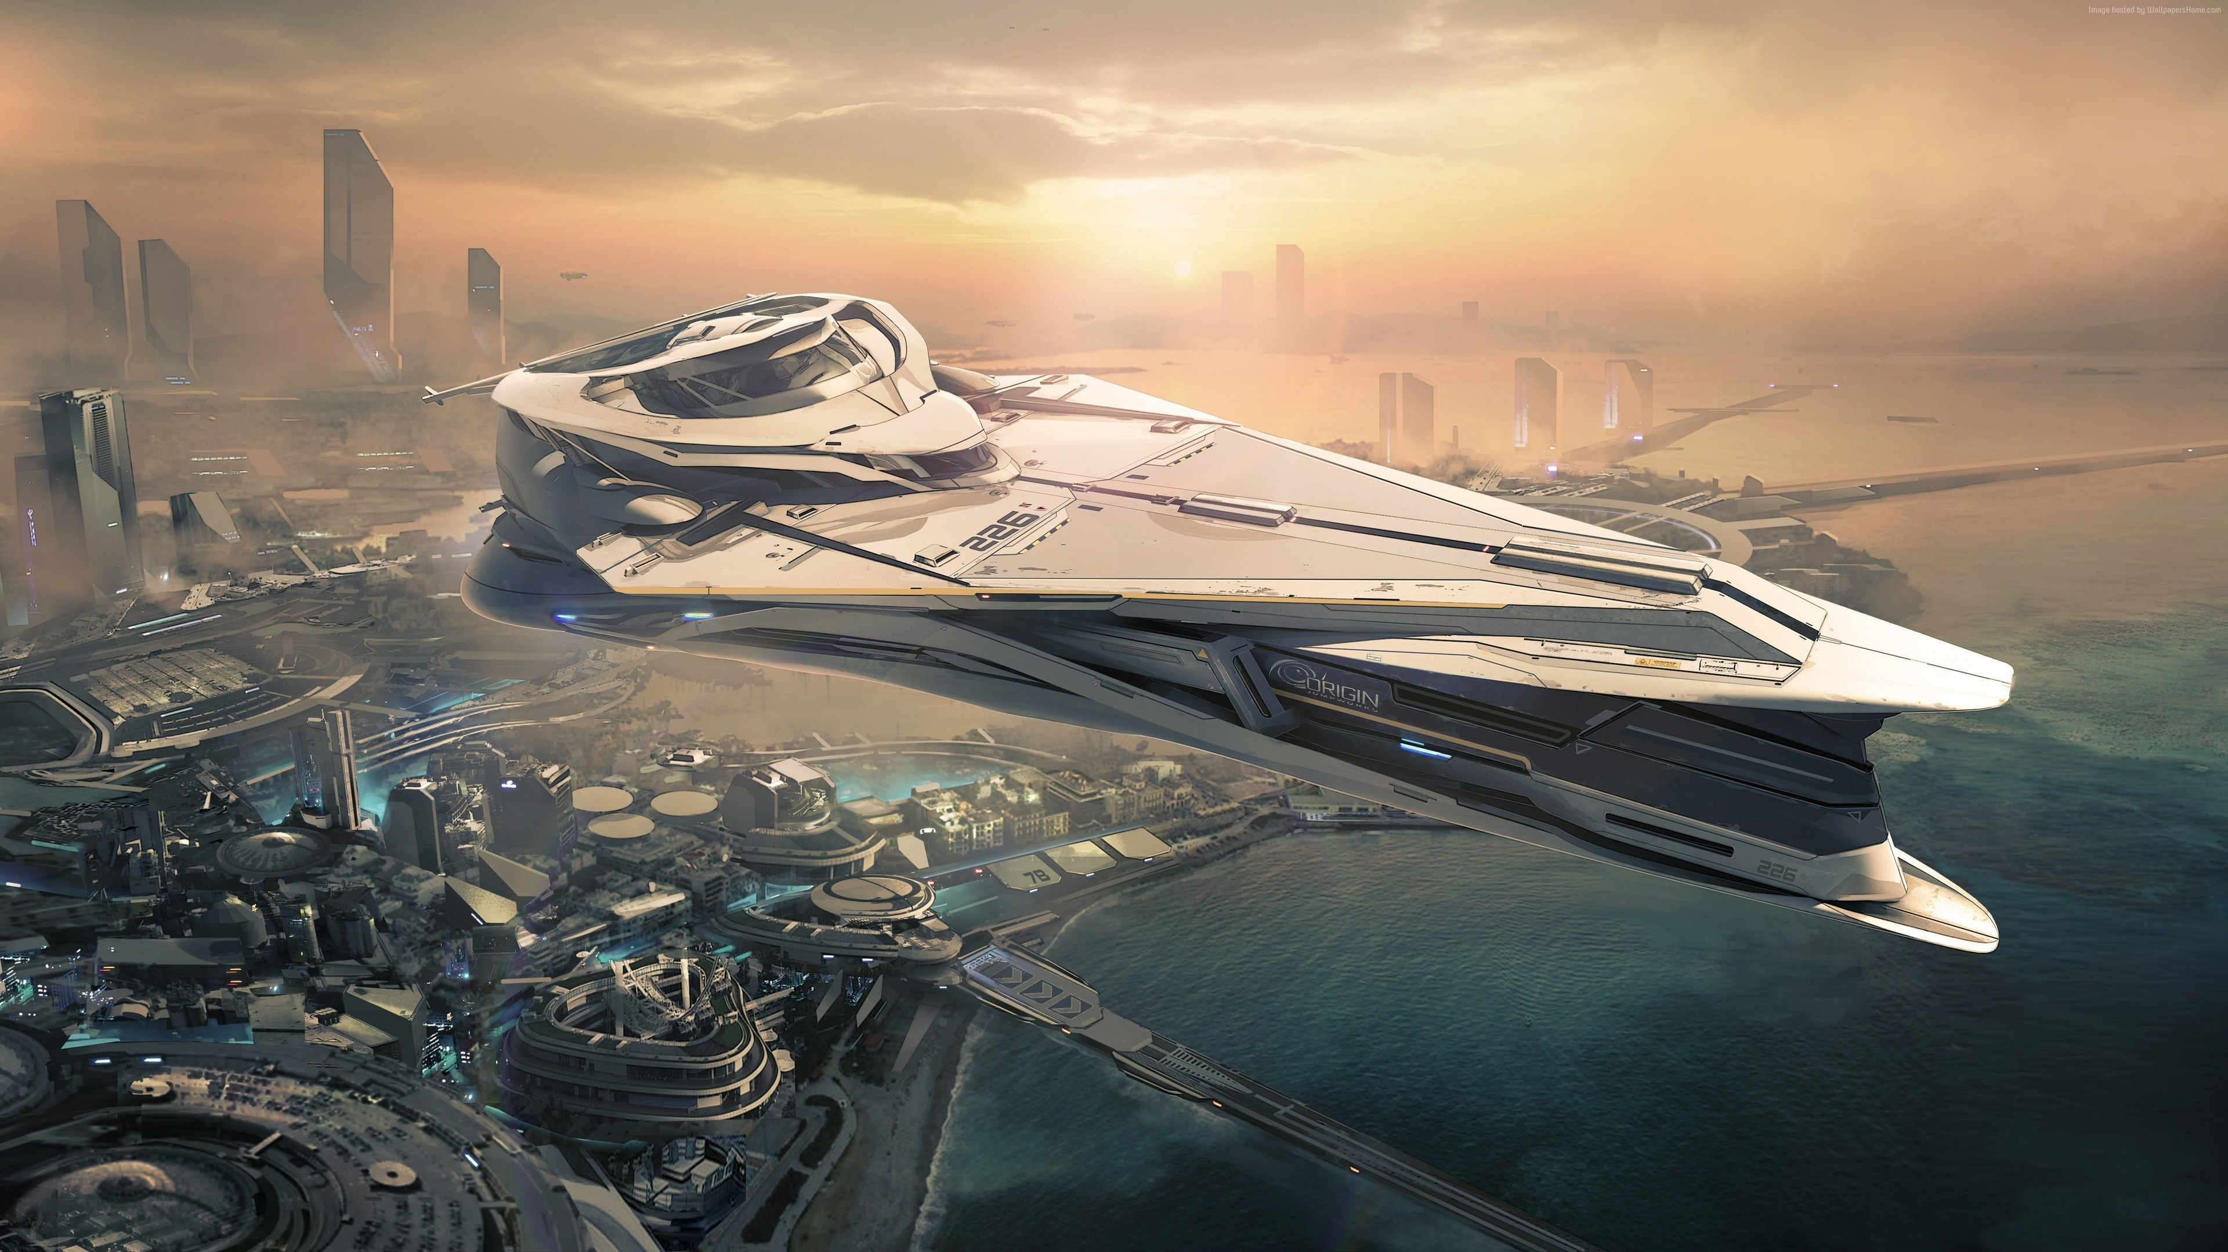
Lilea, Nilea ( 11 million)

